Slide 1

Prediction of Pedestrian Speed with Artificial Neural Networks
Kejia Gao (03779844)
Jingyi Zhang (03785924)
Maximilian Mayr (03738789)
Yizhi Liu (03779947)
Felipe Antonio Diaz Laverde (03766289)
08.07.2024

Slide 2
Contents
Background of the Research
Data preprocessing
Implementation of Weidmann model
Implementation of ANN model

Slide 3
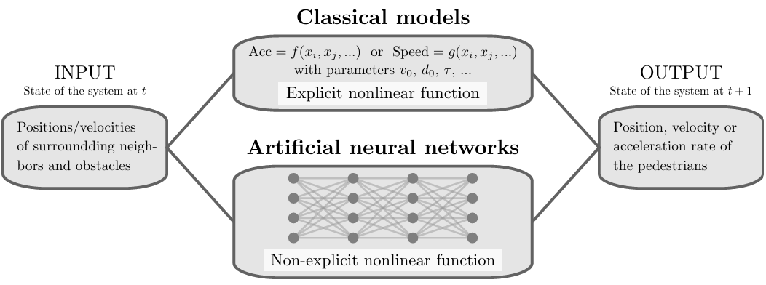
Background of the Research
"Prediction of Pedestrian Speed with Artificial Neural Networks"
by Antoine Tordeux, Mohcine Chraibi, Armin Seyfried, and Andreas Schadschneider

Slide 4
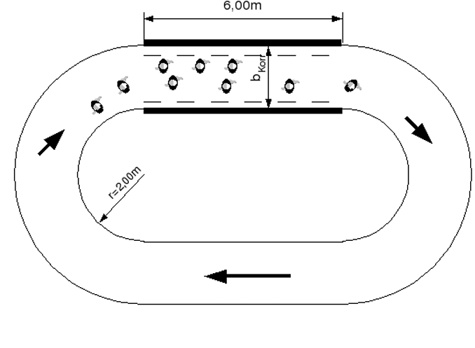
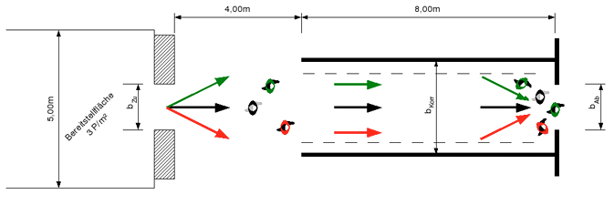
Background of the Research – Data
Project HERMES
Laboratory conditions
Unidirectional
Ring data
Bottleneck data
Sampling frequency 16Hz
50%/50% train-test-split

Slide 5
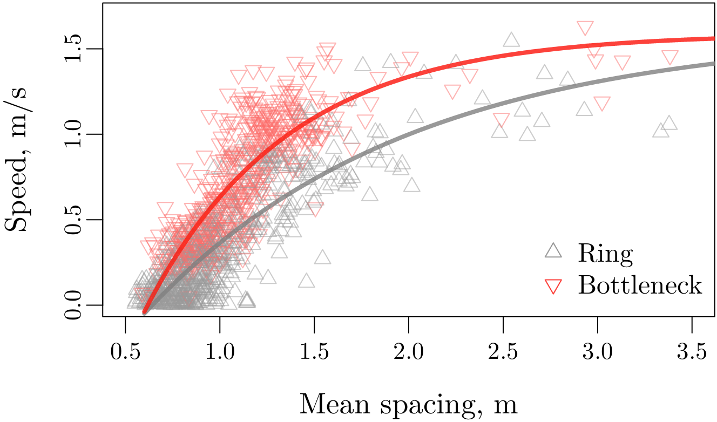
Background of the Research – Data

Slide 6

Background of the Research – Models
Weidmann model
$$v=v_{0}\left(1−\exp\left(\frac{l−{\overline{s}}_{K}}{v_{0}T}\right)\right)$$
Artificial neural network
$$v=NN\left(H, {\overline{s}}_{K},\left(x_{1}−x, y_{1}−y\right), …, \left(x_{K}−x, y_{K}−y\right)\right)$$

Slide 7
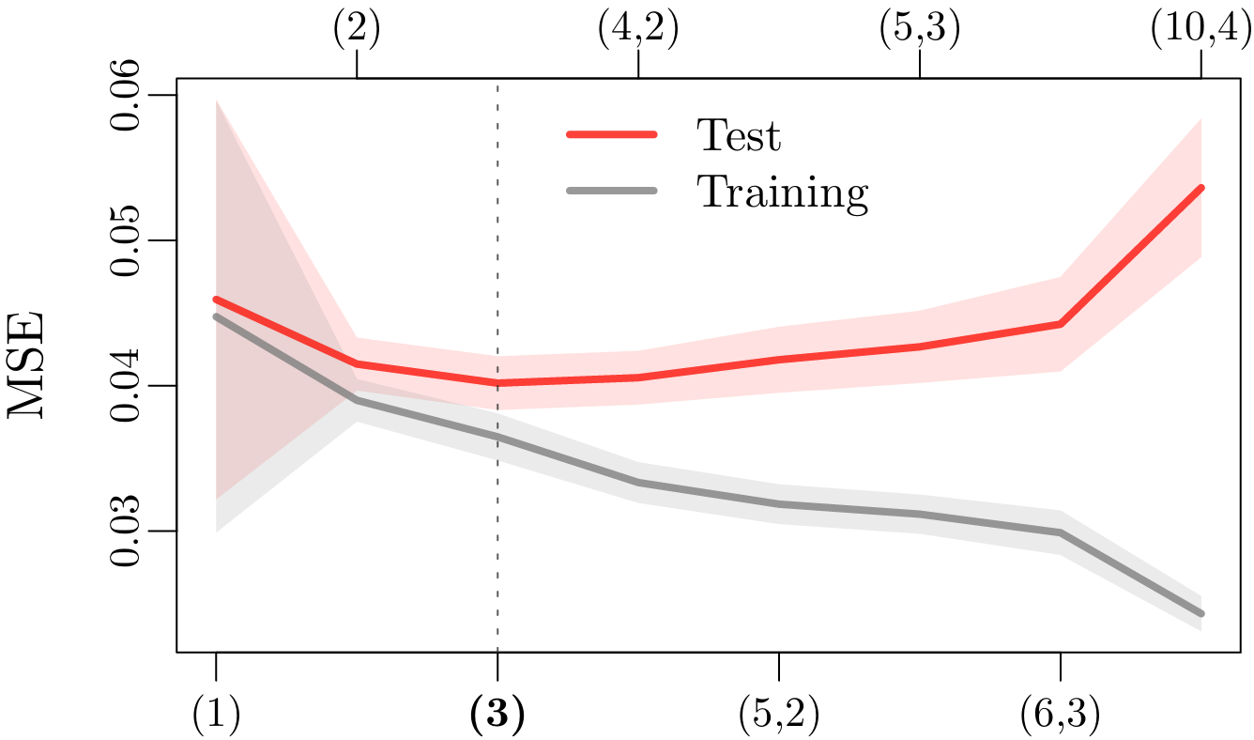
Background of the Research – Results

Slide 8
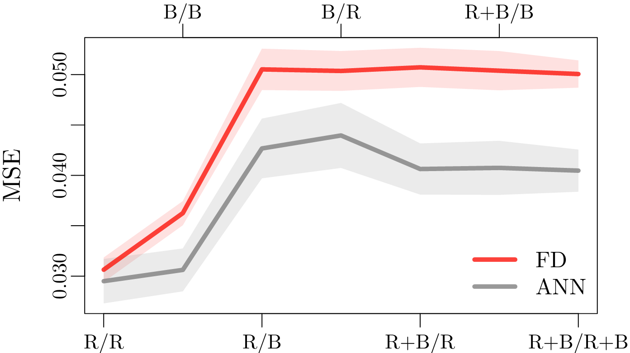
Background of the Research – Results

Slide 9
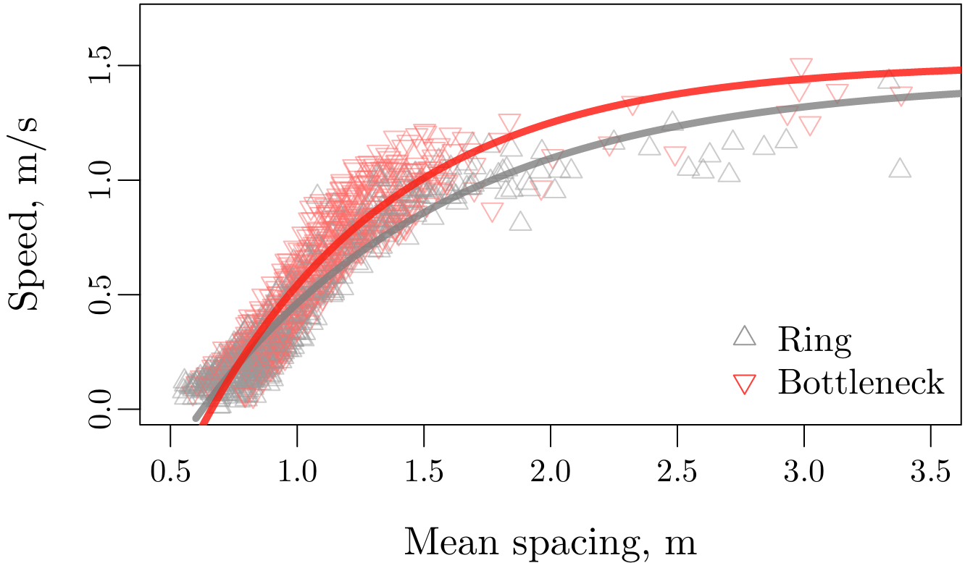
Background of the Research – Results

Slide 10
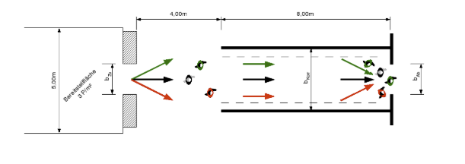
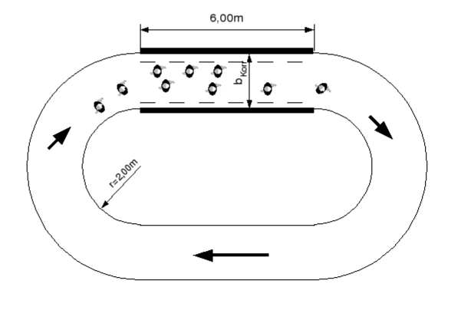
Data preprocessing
Dataset Overview: 2 scenarios
Bottleneck: The width of the system in front of the bottleneck is 1.8 m while the width of the bottleneck varies (from 0.70, 0.95, 1.20 to 1.80 m — 150 participants by experiment)
Corridor: Closed geometry of length 30 m and width 1.8 m for different density levels (the participant number ranges from 15 to 230)
Keip C, Ries K. Dokumentation von Versuchen zur Personenstromdynamik “[J]. Project Hermes, Bergische Universit ̈at Wuppertal, Tech. Rep, 2009.

Slide 11
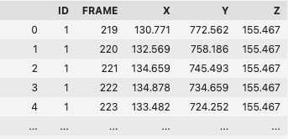
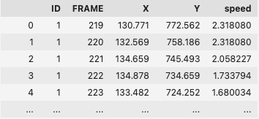
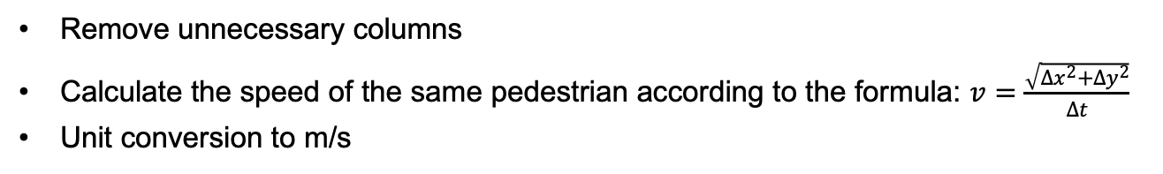
Data preprocessing
Adding speed:
Remove unnecessary columns
Calculate the speed of the same pedestrian according to the formula: $v=\frac{\sqrt{{∆x}^{2}+{∆y}^{2}}}{Δt}$
Unit conversion to m/s

Slide 12
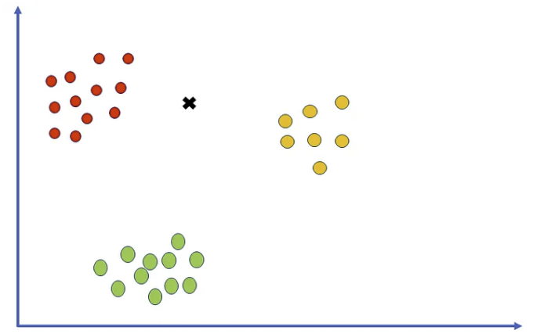

Data preprocessing
Finding nearest neighbors:
Grouping by Frame
Finds the 10 nearest neighbors for each point using Euclidean distance
calculates the mean spacing with the formula:
https://pub.towardsai.net/k-nearest-neighbors-knn-algorithm-tutorial-machine-learning-basics-ml-ec6756d3e0ac
Feature: Distance to neighbors, mean spacing (21-dimensioanal)
Target: Speed

Slide 13
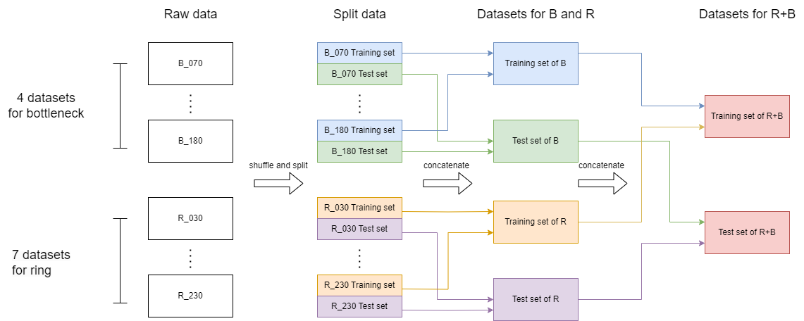
Implementation of ANN model – Training set and test set
Different combinations of training set/test set:
'R/R', 'B/B', 'R/B', 'B/R', 'R+B/R', 'R+B/B', 'R+B/R+B'

Slide 14
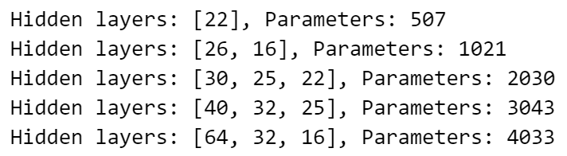
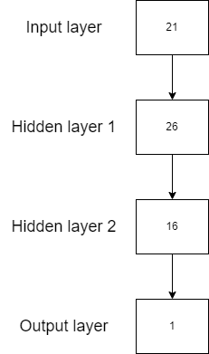
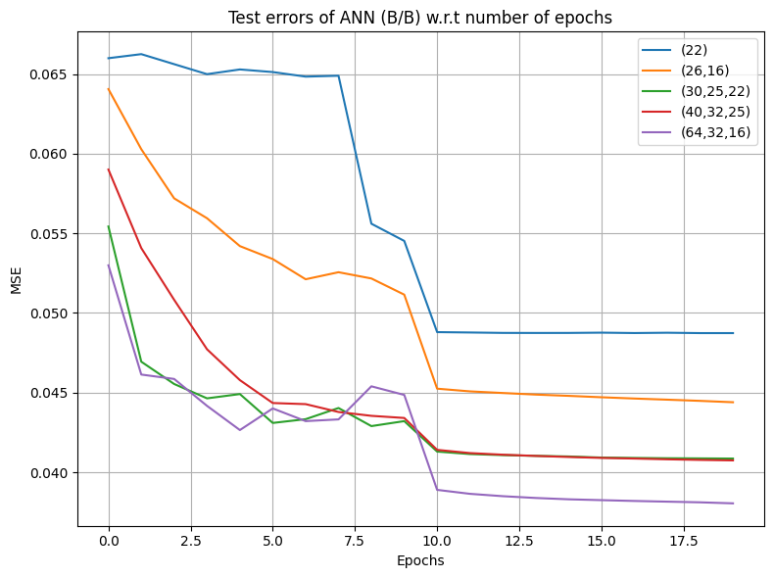
Implementation of ANN model – ANN model
An example
Different architectures of hidden layers:
Test errors of ANN on dataset R+B/R+B w.r.t number of epochs
Todo: Pick the best architecture and train the model with 7 combinations of training set/test set.

Slide 15
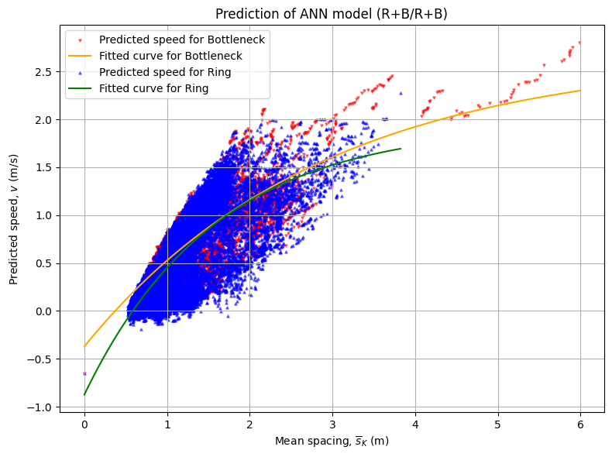
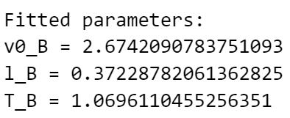
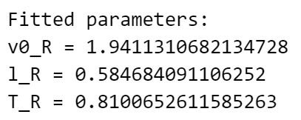


Implementation of ANN model – Comparisons
ANN vs Weissmann:
Test errors (MSE)
Distribution of predictions w.r.t. mean spacing
3 fitted parameters $v_{0}$, l and T
Weidmann model
$$v=v_{0}\left(1−\exp\left(\frac{l−{\overline{s}}_{K}}{v_{0}T}\right)\right)$$
Using the predictions of ANN, fit the 3 parameters for both scenarios: bottleneck and ring.

Slide 16
Thanks for your attention! Questions? Please feel free to ask!

